Slide 1





Python coding with ChatGPT
Python coding with ChatGPT
ChatGPT can help you code even if you are not a programmer and have limited experience.
They allow you to describe what you want to do in plain text, and writes code for you based on your instructions.
You can use ChatGPT to:
Generate code from scratch
Explain code
Improve existing code
Troubleshoot code and fix bugs
Provide feedback on your code
Document your code
Brainstorm approaches

Slide 2

Case 1 - Generating code from scratch and using Canvas
ChatGPT has a Canvas functionality.
Works as a virtual environment or sandbox, which is hosted by a server and which is deleted once you are done
Allows you to write, correct, and execute a Python script that ChatGPT can also edit
Prompt:
Write a Python script which I can execute via the canvas functionality, which greets me and tells me the time. You don’t have to consider timezones.

Slide 3
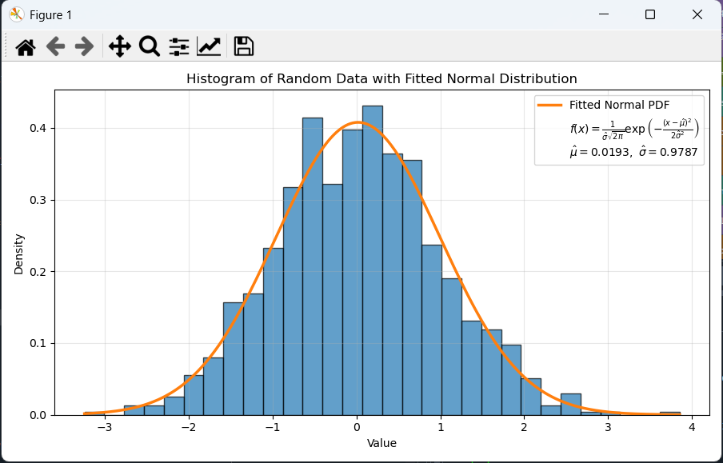
Case 2 - Generating code for local execution
Canvas cannot load files (the terminal is not local), it cannot display or save plots or new files
Copy/paste code from ChatGPT to a Python interpreters e.g. Spyder or Jupyter
Prompt
Write a Python script that I can execute in Spyder, which generates a dataset of 1000 random numbers, where the overall population follows a normal distribution. Fit the distribution with a normal function, and plot both the distribution histogram as a barplot and the fitted line along with its equation in the legend.

Slide 4
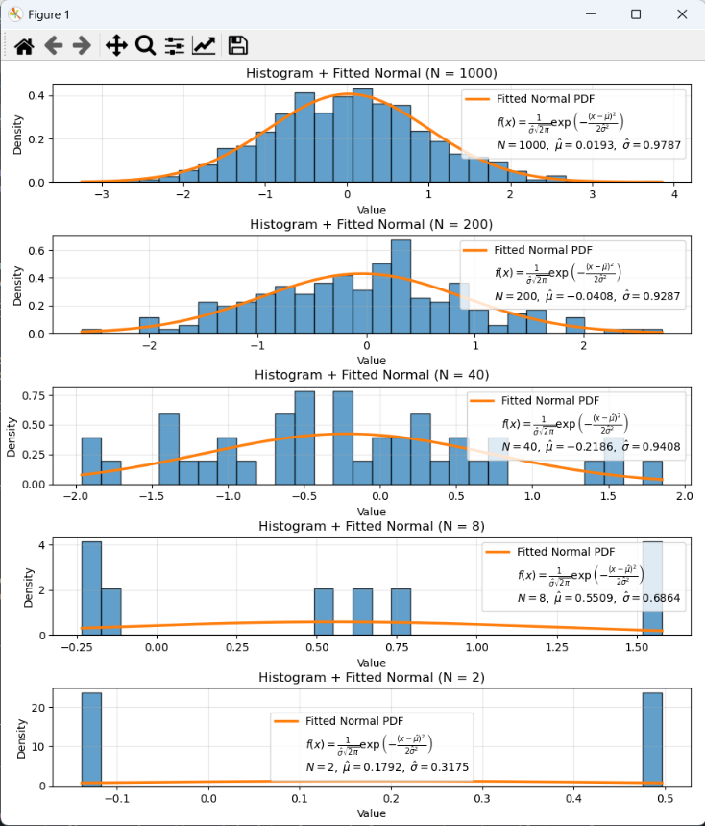
Case 2 - Generating code for local execution
You can still build on the code:
Via ChatGPT memory
Copying the entire code into our prompt (make sure nothing is sensitive or GDPR related)
Prompt
I want to produce 5 of these plots, but where we decrease the number of data points by a factor of 5 between plots. The plots should be displayed in a column within the same figure. I want the total number of datapoints to be a variable that users can adjust easily.

Slide 5
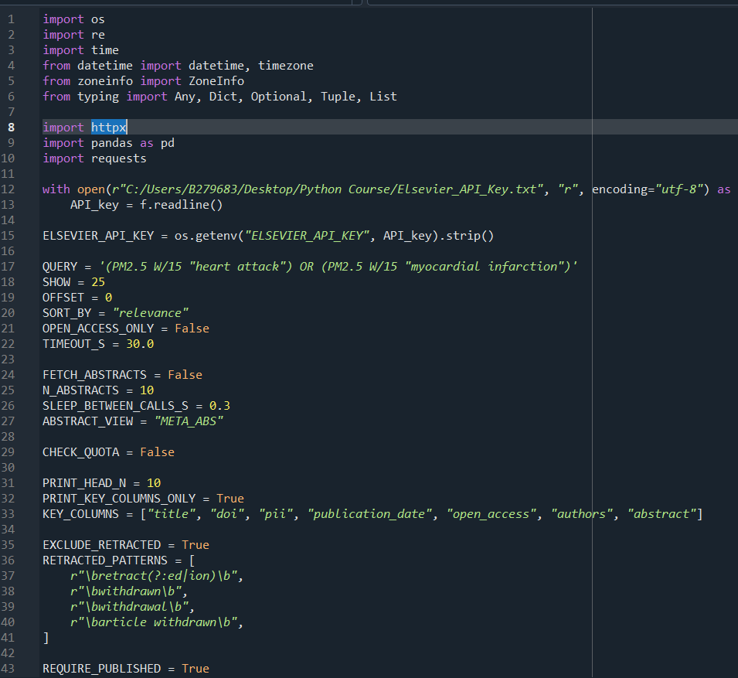
Case 3 - Explaining and documenting code
ChatGPT can help you understand complex code
It can summarize the overall functionality
It can make inline comments to explain what a given code paragraph does
Let's test it on the script called "Code for commenting.py".
Prompt
Can you in plain words explain and summarize what this code does? Keep the answer short and concise without repetition.

Slide 6
Case 3 - Explaining and documenting code
ChatGPT is very good at explaining code but it can also document code, so its easier for others to read!
Inline comments, docstrings for functions, and sectioning are crucial to make code easy to read!
The code we just looked at has been stripped of all inline comments, sectioning, and docstrings
We can ask ChatGPT to recreate these, giving us a clearer idea of what happens in different parts of the script.
Prompt
I want you to add inline comments, sections, and function docstrings to this code, so its easier for readers to see what is happening when.

Slide 7
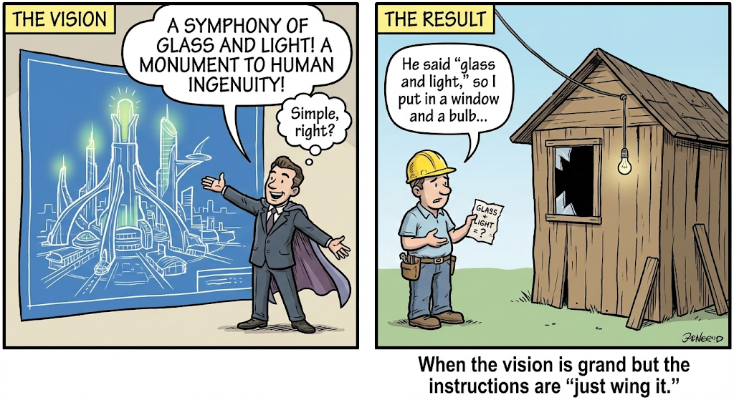
Case 4 - Loading and visualizing data
ChatGPT always needs proper context and clear instructions
However, ChatGPT is a pleaser, so it will always generate something instead of asking follow-up questions
Provided vague and broad tasks it will generate extensive code to safeguard all kinds of scenarios
Results are never as intended…
Prompt
I have several data files from a campaign and I want to analyze these data files using Python. They are csv files, can your write a python script to load, plot and analyze them?

Slide 8
Case 4 - Loading and visualizing data
A good prompt for ChatGPT will include a clear context, so that ChatGPT will know what to do and how we want it to do it. You can use context, role, rules, and task to give a more structured input and give ChatGPT a clearer idea of how to answer and behave
Prompt
**Context:**
I want to use Python to load and treat data from a scientific measurement campaign where we used an optical particle sizer (OPS) from TSI to measure particle number and size. My data is in several .csv files from the OPS instrument. Each file contains 37 header lines with metadata, followed by a number of comma separated columns with the desired data. The first column is elapsed time in seconds followed by 17 size bins and some additional metadata columns.
**Role:**
You are an expert Python programmer, who is instructing, explaining, and teaching me how to code and who helps me develop code.
**Rules:**
You have to be concise and stick to the instructions instead of building an unnecessarily large script. You need to keep the code simple, easy to use, well-documented, and functioning.
**Task:**
I need you to write and explain a simple Python script that I can execute in Spyder to load and visualize my data as a heatmap plot of time (x) vs particle size (y) colored by particle concentration (z).

Slide 9
Case 4 - Loading and visualizing data
Remember to check and be critical!
Is the outcome as expected?
Could there be errors?
How can you check and verify?
Check the datafile!

Slide 10
Case 4 - Loading and visualizing data
Remember to check and be critical!
Is the outcome as expected?
Could there be errors?
How can you check and verify?
Check the datafile!
If we don’t have any sensitive data, we can upload an example file to ChatGPT
This gives ChatGPT a much better understanding of our data, allowing it to adjust the code much more efficiently than based on our often limited description.

Slide 11
Case 4 - Loading and visualizing data
Remember to check and be critical!
Is the outcome as expected?
Could there be errors?
How can you check and verify?
Check the datafile!
If we don’t have any sensitive data, we can upload an example file to ChatGPT
This gives ChatGPT a much better understanding of our data, allowing it to adjust the code much more efficiently than based on our often limited description.
Prompt
It works, but I would like to make some changes to the code and the plot. I have uploaded one of the data files, I want you to open it and read its content, giving you a better understanding of the data format.
I want you to update the code so that:
The particle sizes in my plot are the actual particle sizes determined from the bin edges (cut points) reported in the metadata header.
Elapsed time is converted to actual time using the starting time displayed in the metadata header.
Ensure that potential missing data is included as NaN values in the plot
Redo the plot with the new information

Slide 12

Case 5 – Managing memory and context
One issue with ChatGPT is its memory
In long conversations and prompts, it will forget context (especially when copying large code segments back and forth)
ChatGPT 5.2 has a context window of roughly 400.000 tokens (1 token ~ 4 characters)
However the context window includes:
User input
Answer to user
Reasoning (internal memory)
Results from tools (function such as web searches)
Memory of previous prompts and answers

Slide 13
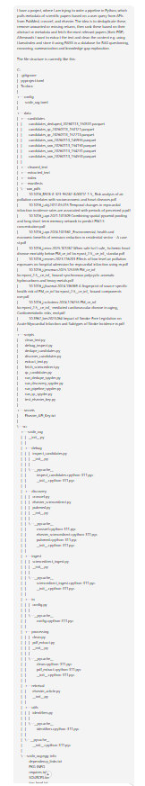
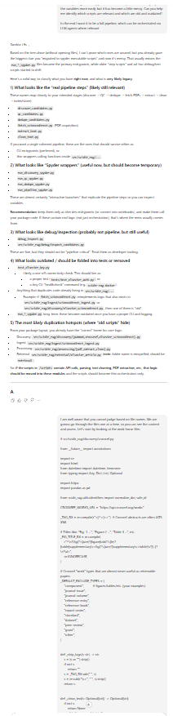
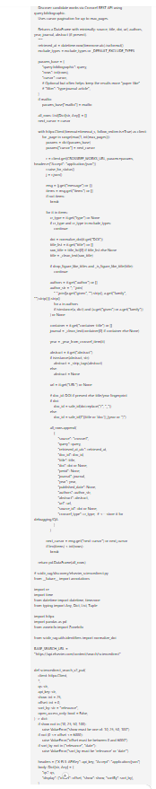
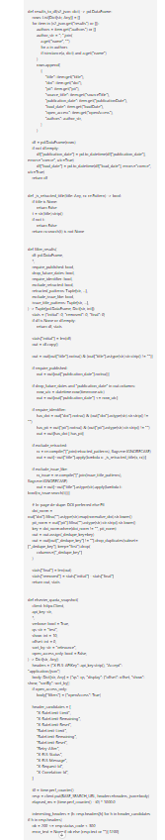
Case 5 – Managing memory and context
New chats will have the full context in memory
Longer chats will truncate or summarize
Start a new chat when its incoherent or slow
Maintain a short “working spec” message (goals, constraints, definitions, methods, considerations)
Give this as a starting point to new chats
Ask ChatGPT to update the file
Ask ChatGPT to summarize the important points of the current chat, to transfer knowledge efficiently
Store related chats as a “Project”
Enables context retrieval (to some extent)
Limits crosstalk between chats
Summarized or forgotten
In memory

Slide 14
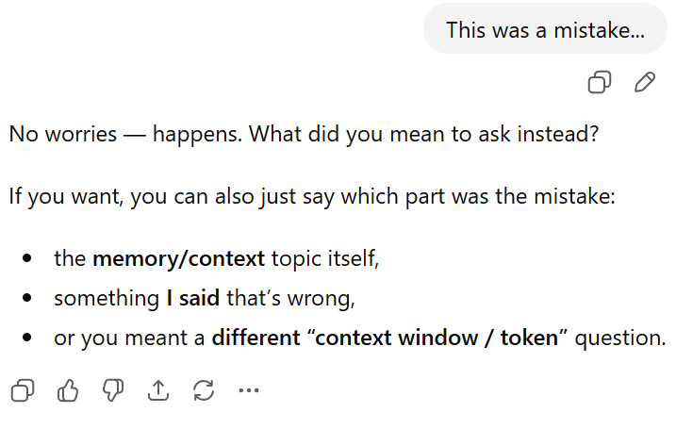
Case 5 – Managing memory and context
Use the pencil to edit chats!
If you work with large projects, consider to:
Break your project into smaller working pieces
You can load functions from other files (that’s what packages are!)
Enables you to limit the chat context
Makes it easier to extend the code
Makes it easier to debug
Smaller projects are less sensitive to structuring and can live in one file
Orchestrator
Loaders
Load Instrument1
Load Instrument2
Formatting
Formatter1
Formatter2
Plotting
Plot1
Plot2
Plot3
Helpers
Various loading helpers
Various format helpers
GUI builder
Build overlay
Moving pieces
Connectors
App initiator

Slide 15
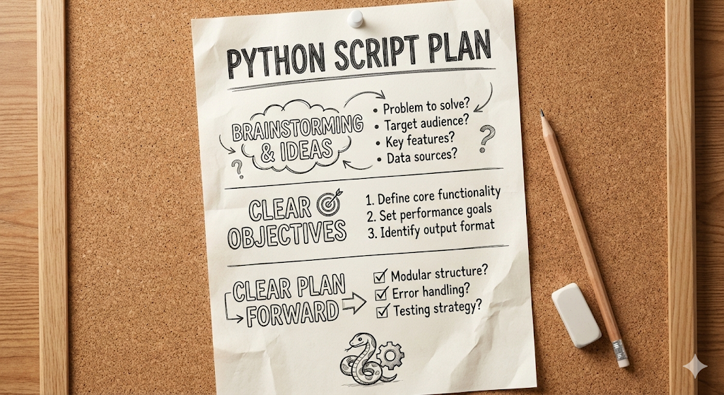
Case 6 – Optimizing and improving code
Any good project starts with a clear objective and plan
Invest time into brainstorming and planning!
Use ChatGPT to help you brainstorm
Make a clear step-by-step plan that you can follow
Investigate what tools you can use – maybe someone already did what you need or parts of it?
Keep versions of your code!
You never know when ChatGPT is going to break it!
Allows you to go back to a stable version if developments go haywire
Ask ChatGPT to help you improve your code:
How to shorten, optimize, or document it
Give suggestions for improvements
Help you refractor your code (split it into different files)
Prompt:
Give me 5 suggestions for new features that I can implement in the code below

Slide 16

Final comments
Python is a versatile language that can perform many tasks!
Numerical and categorical data treatment and pipelines
Plotting an visualization
Image and video treatment
Build graphical user interfaces
Perform tasks involving machine learning and AI e.g. LLM communication
Do web scraping and knowledge gathering
Interact via APIs e.g. for
Online databases
Instruments and hardware
Read serial and USB inputs
There are many possibilities, so if you have an idea or a potential use-case, you can always ask us or ChatGPT!
Questions?
Time for some hands-on experience!

